Slide 1
Advanced Leopard Seal Recognition System (ALSRS): Sprint 6
Bryce Robinson, Carson Buntin, Carsyn Smeda, Nathan Hontz, Juncheng Li, Ryan Huntington, Omar Darwish
Seal Team 6

Slide 2
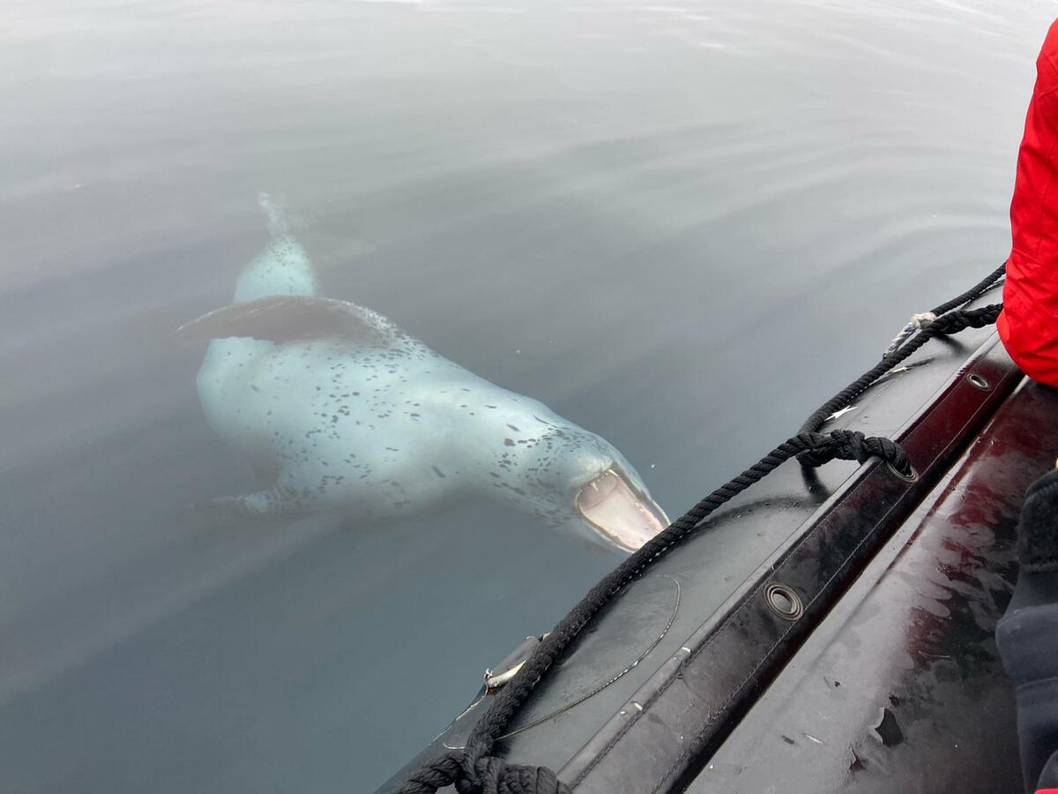
Project Review
Current lack of effective tools to detect and identify individual leopard seals
Develop API for Happywhale.com capable of receiving leopard seal photographs and returning the identity of any recognized seals
Utilization of two machine learning models for detection and identification of leopard seals
Notes:
Juncheng

Slide 3
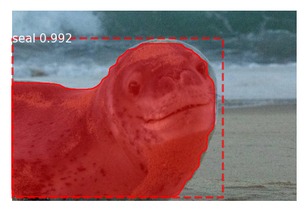
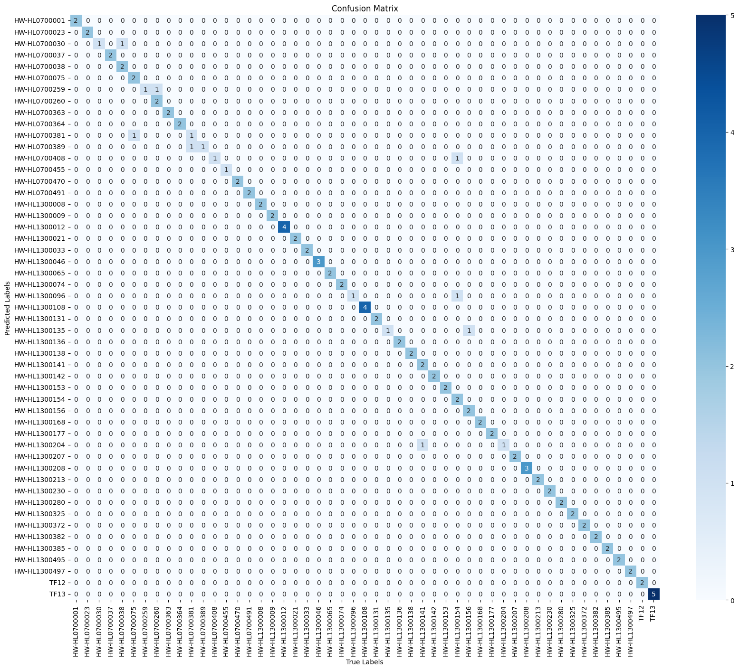
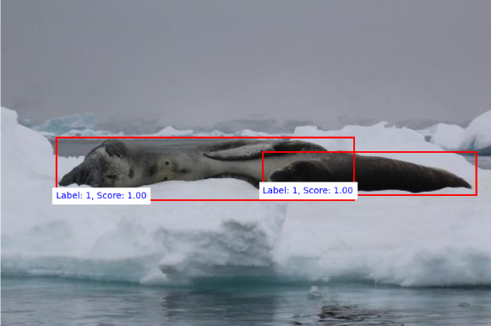
Finalizing all weights
Retrained each model a final time and exported weights with best results
DeiT: Top 1 Accuracy = 94%, Top 5 Accuracy = 99%, BAC = 92%, F1 = 92%
Mask-RCNN: mAP score = 0.91. Detection of both seals & non-seals
Faster RCNN: Detection for only leopard seals, Precision = 99%, Recall = 98.74%, F1-score = 99.37%
Notes:
Ryan

Slide 4
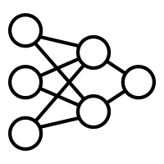
Retraining Scripts
Each model has retraining scripts if more fine-tuning is needed
Dataset preparation also has script
Scripts take zip file to dataset currently
Can be extended to future solutions easily
Different steps to retrain each model
Documentation on how to prepare data for each specific model
Notes:
Nathan

Slide 5
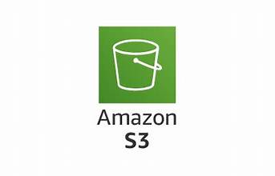
S3
Set up S3 bucket for testing
Allow for users to send S3 key to API then the key is used to retrieve the image
Eliminates the need for images to be sent to the API
Notes:
Carson

Slide 6
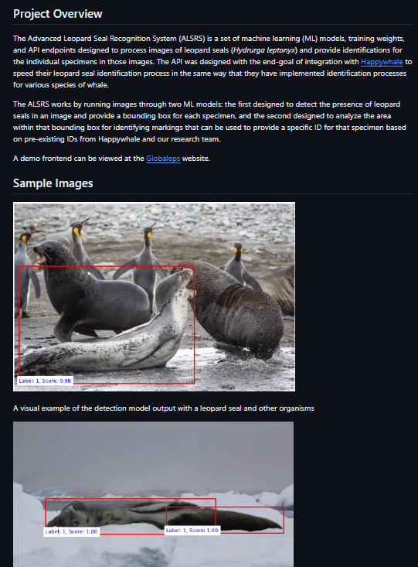
Documentation
Project Overview
Model Output Visualizations
New Installation steps
Bash Scripts
Manual Installation
Retraining Documentation
Notes:
Bryce

Slide 7
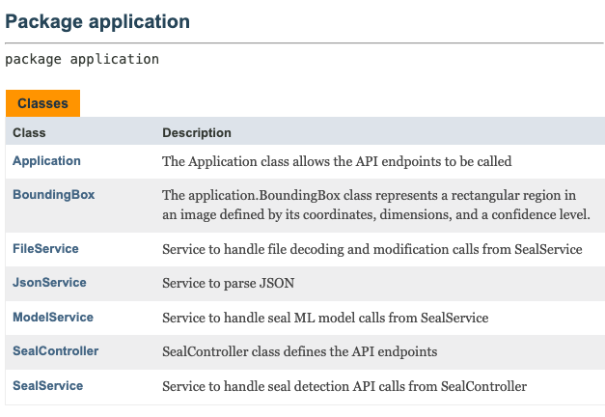
Code Cleanup
Removing unused imports, methods, data members, files
Refactoring duplicate code
Fixing all JavaDoc errors and warnings, standardizing format
Moving files from being developer hosted to client hosted
Notes:
Bryce

Slide 8
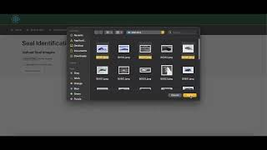
Demo
Notes:
Carsyn

Slide 9
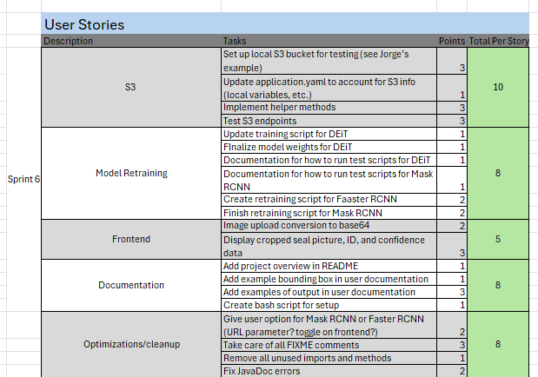
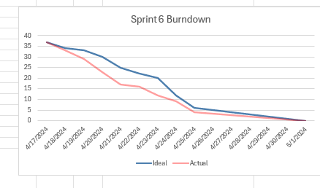
Burndown Chart and User Stories
Notes:
Carson

Slide 10
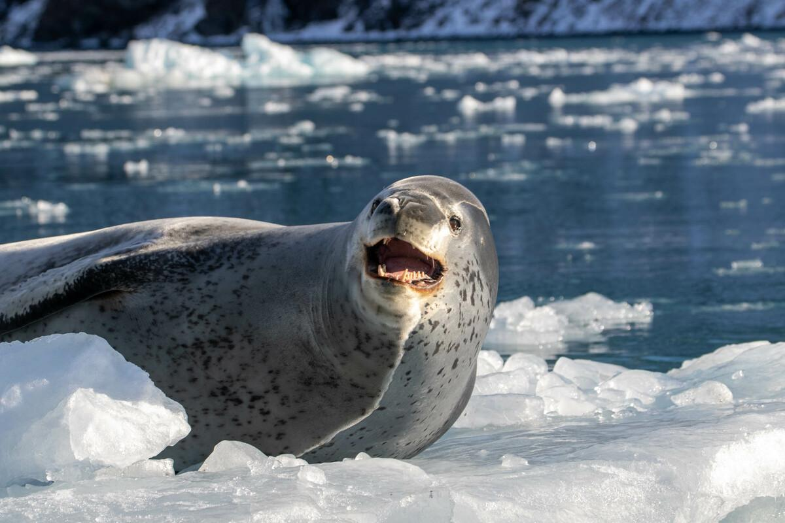
Potential Future Development
Store datasets on S3 bucket for mutual access
Automate the addition of new seals into the datasets
Local python server to continuously run models
Notes:
Ryan

Slide 11
Questions

